Slide 1
Colossians 4:7–18 (NLT)
⁷ Tychicus will give you a full report about how I am getting along. He is a beloved brother and faithful helper who serves with me in the Lord’s work. ⁸ I have sent him to you for this very purpose - to let you know how we are doing and to encourage you.

Slide 2
⁹ I am also sending Onesimus, a faithful and beloved brother, one of your own people. He and Tychicus will tell you everything that’s happening here. ¹⁰ Aristarchus, who is in prison with me, sends you his greetings, and so does Mark, Barnabas’s cousin. As you were instructed before, make Mark welcome if he comes your way.

Slide 3
¹¹ Jesus (the one we call Justus) also sends his greetings. These are the only Jewish believers among my co-workers; they are working with me here for the Kingdom of God. And what a comfort they have been!

Slide 4
¹² Epaphras, a member of your own fellowship and a servant of Christ Jesus, sends you his greetings. He always prays earnestly for you, asking God to make you strong and perfect, fully confident that you are following the whole will of God.

Slide 5
¹³ I can assure you that he prays hard for you and also for the believers in Laodicea and Hierapolis. ¹⁴ Luke, the beloved doctor, sends his greetings, and so does Demas.

Slide 6
¹⁵ Please give my greetings to our brothers and sisters at Laodicea, and to Nympha and the church that meets in her house. ¹⁶ After you have read this letter, pass it on to the church at Laodicea so they can read it, too. And you should read the letter I wrote to them.

Slide 7
¹⁷ And say to Archippus, “Be sure to carry out the ministry the Lord gave you.” ¹⁸ Here is my greeting in my own handwriting - Paul. Remember my chains. May God’s grace be with you.

Slide 8
Good and FAITHFUL Servant
Colossians 4:7-18

Slide 10
Galatians 2:20 (NLT)
My old self has been crucified with Christ.
It is no longer I who live, but Christ lives in me.
So I live in this earthly body BY trusting in
the Son of God, who loved me and
gave Himself for me.

Slide 11
S
S
S

Slide 13
2 Timothy 4:9–10 (NIV)
⁹ Do your best to come to me Quickly,
¹⁰ for Demas, because he loved
this world, has DESERTED me...

Slide 15
⁸ I am sending him to you for the express
purpose that you may know about our
Circumstances and that he may
ENCOURAGE your hearts.

Slide 16
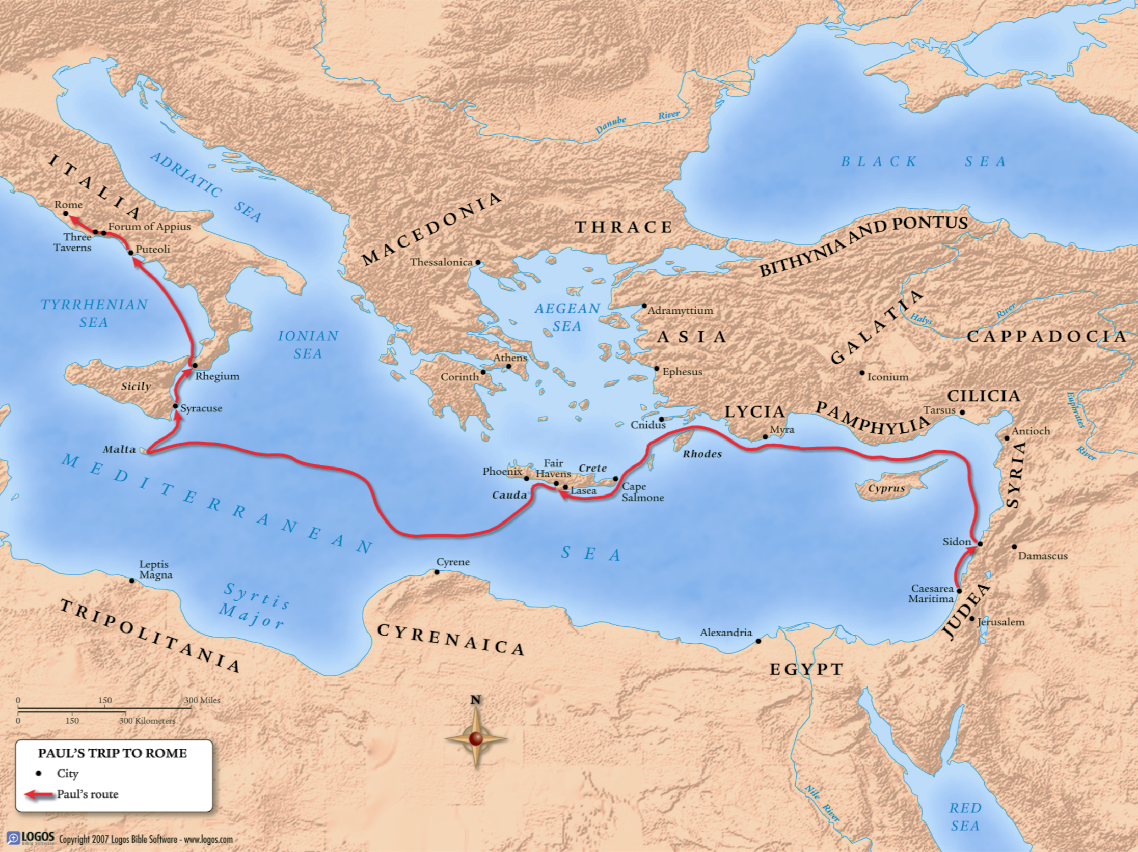

Slide 17
Someone has said that the
Greatest Ability in the world
is Dependability, and this is true.
Constable

Slide 18
There is GREATNESS in smallest
things done FOR Christ. PTW

Slide 19
They are Real, Ordinary people, who
Helped Paul carry out an extraordinary
ministry for the sake of an
Extraordinary Savior.
HNTC

